Slide 1
Screens designed while at Students Loan Company
Department of Education
Purpose of this presentation is to present screens designed while at Students Loan Company. The screens to follow in this presentation are presently live and can be accessed from.
https://www.student-finance.service.gov.uk/customer/apply/ft/1920/pages/aboutyou.xhtml
My involvement in UX design was to make proposals on positioning of screens and Axure Prototyping. Met the real world users during Usability Testing and AB Testing to iteratively develop prototypes.
Screens designed were positioned in the following sections of the progress bar
1. About You - Questions on whether the user has any child and adult dependants
5. Living Costs
Do you want to apply for ADG and Page on extra help for students with dependant children?
Do you want to apply for PLA and CCG?
7. Financial Info
Details of dependant children
Do you want to add another child dependant?

Slide 2
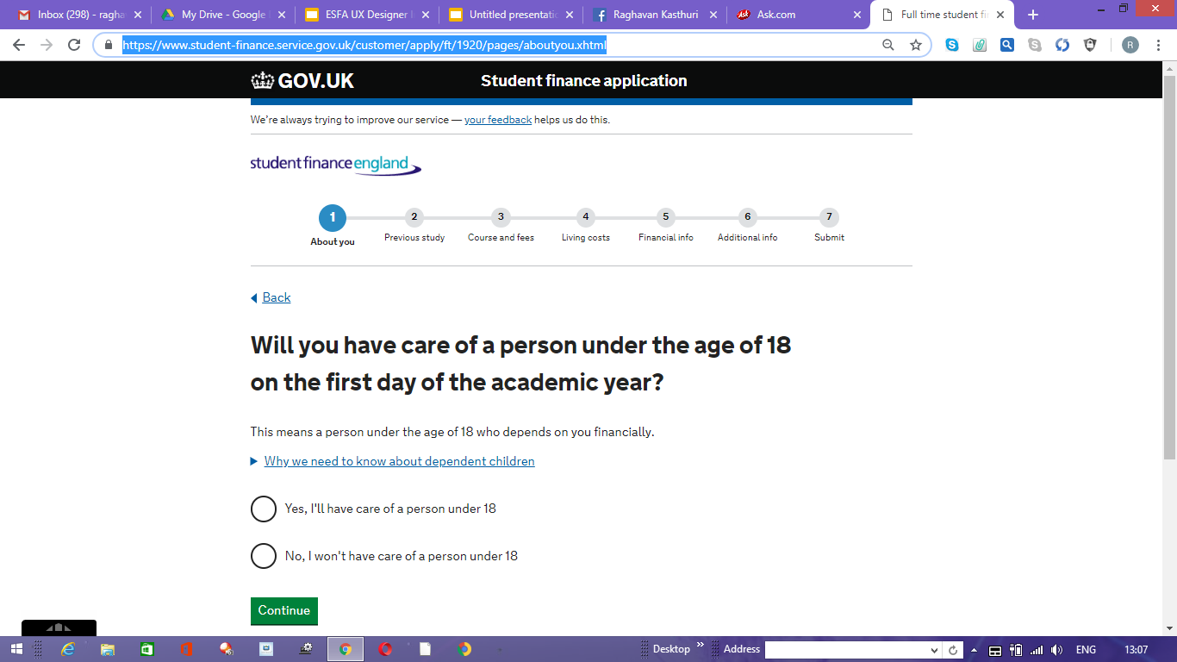

Slide 3
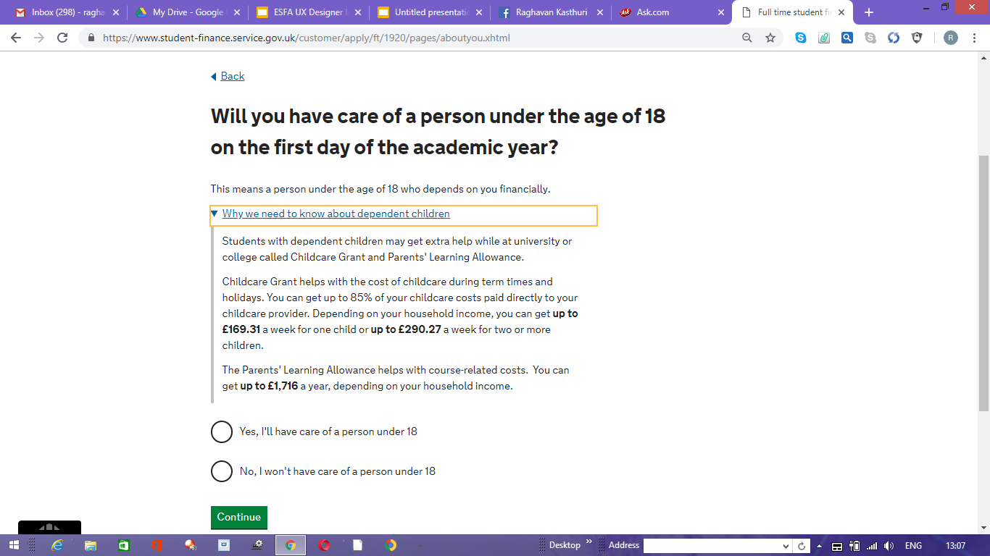

Slide 4
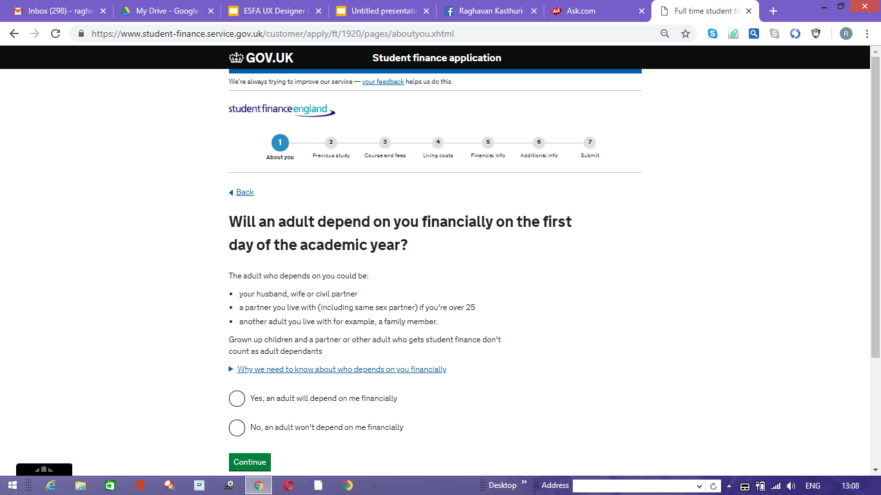

Slide 5
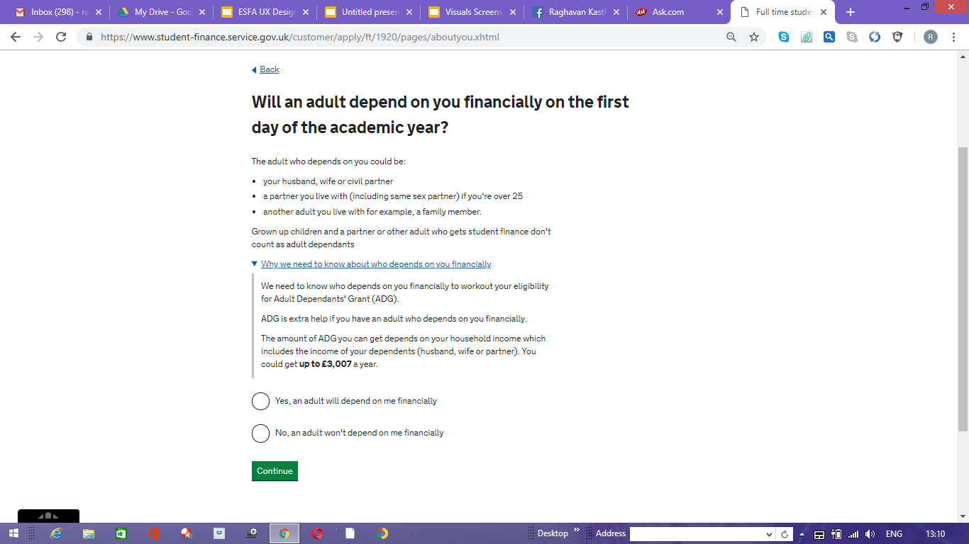

Slide 6
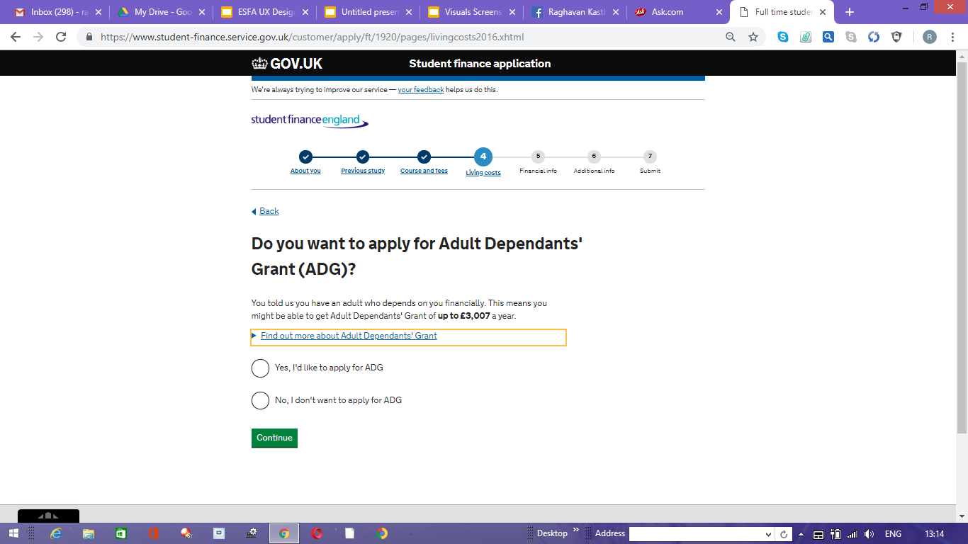

Slide 7
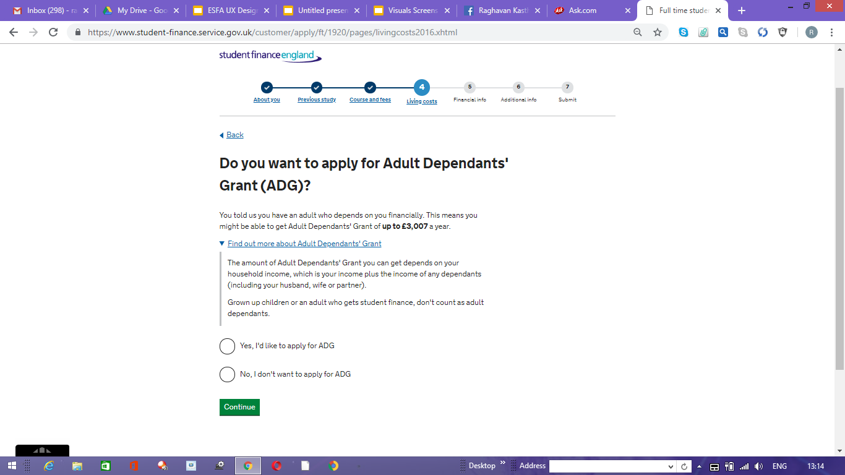

Slide 8
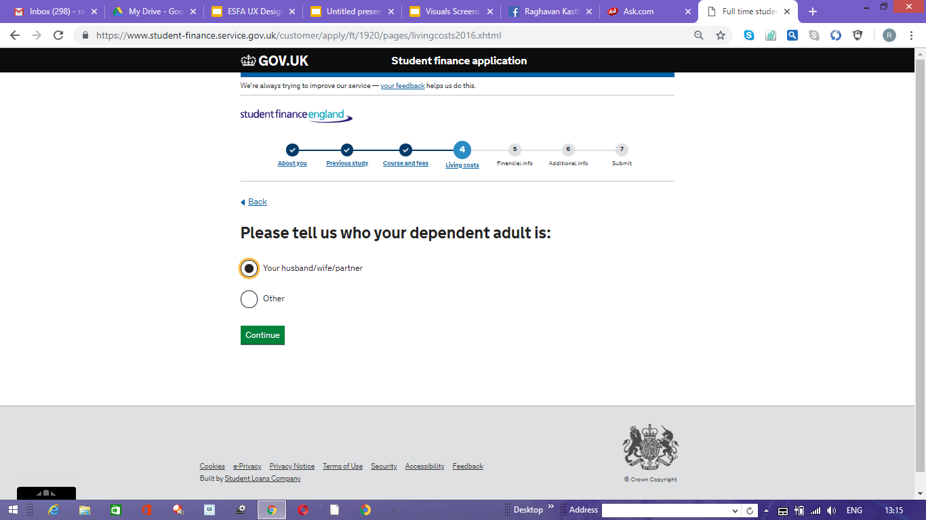

Slide 9
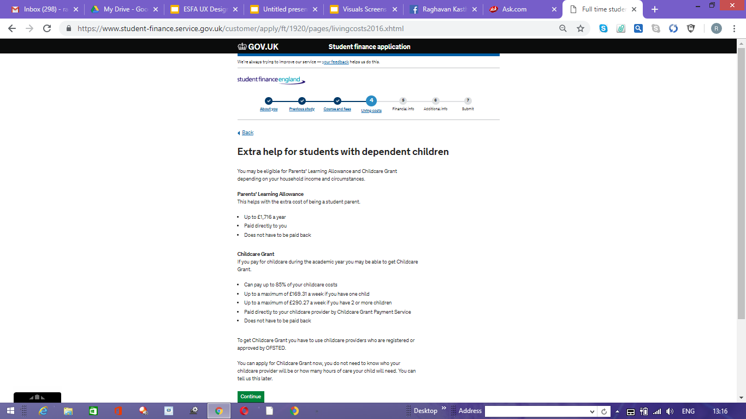

Slide 10
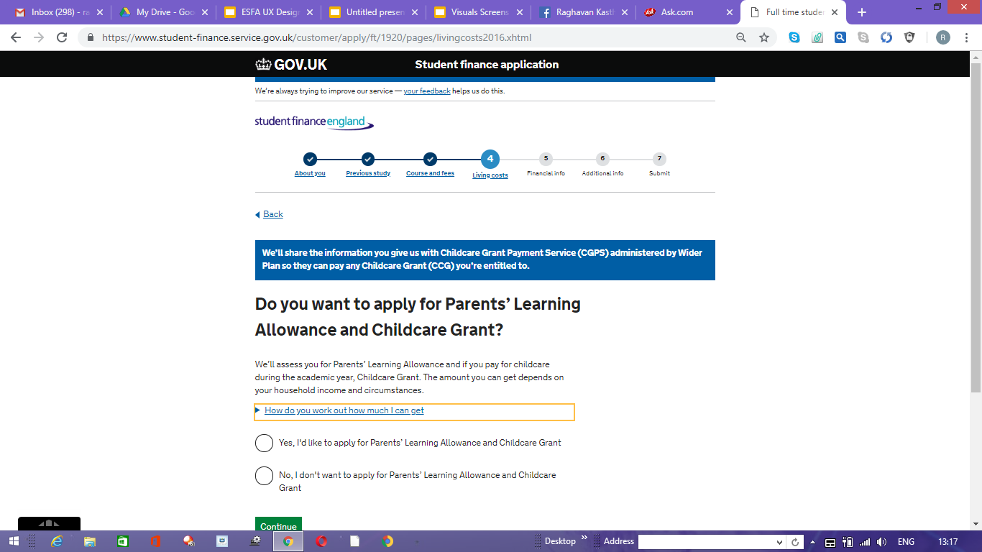

Slide 11
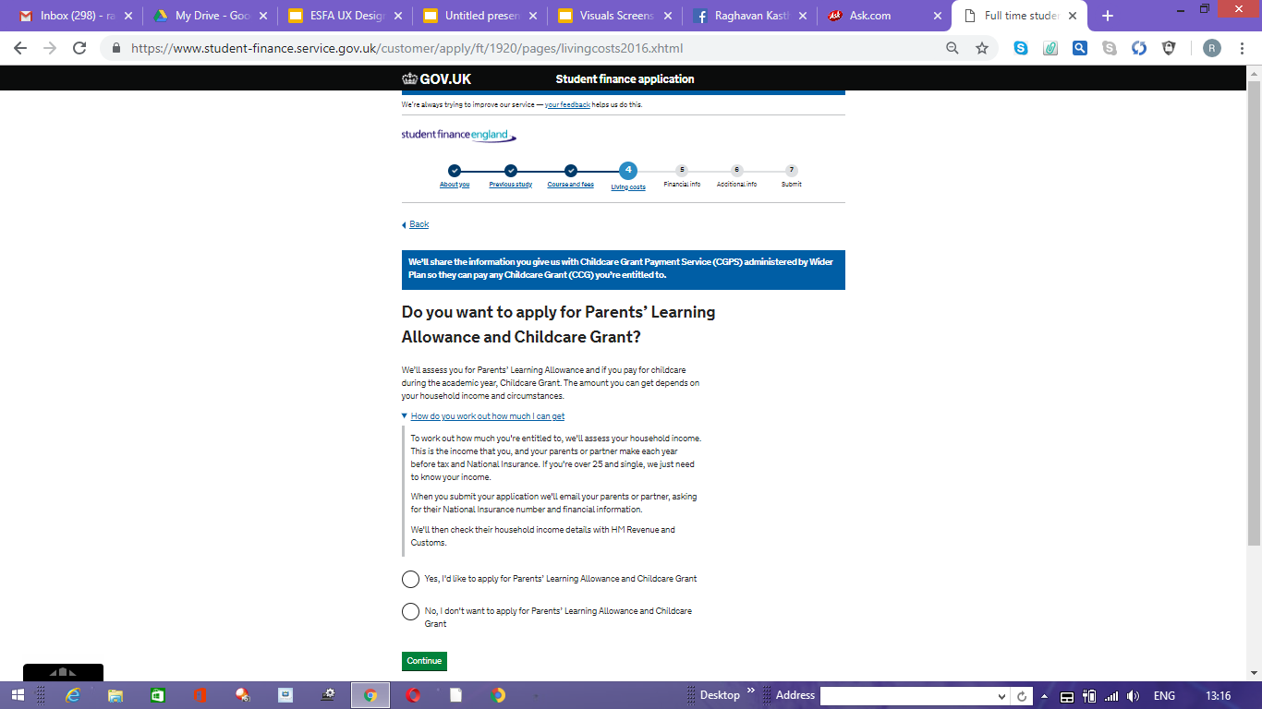

Slide 12
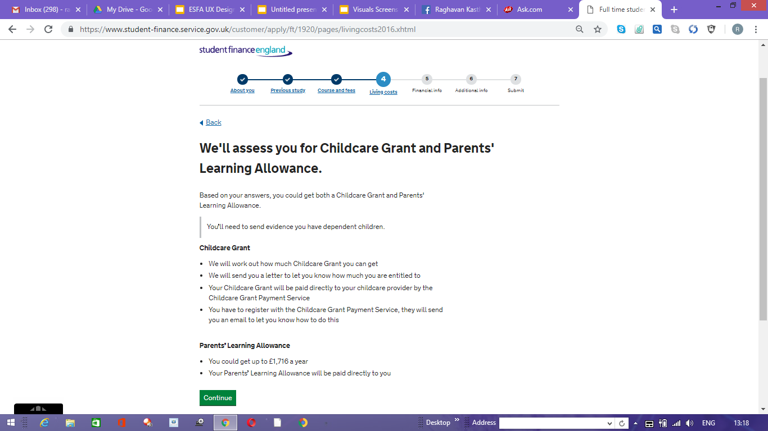

Slide 13
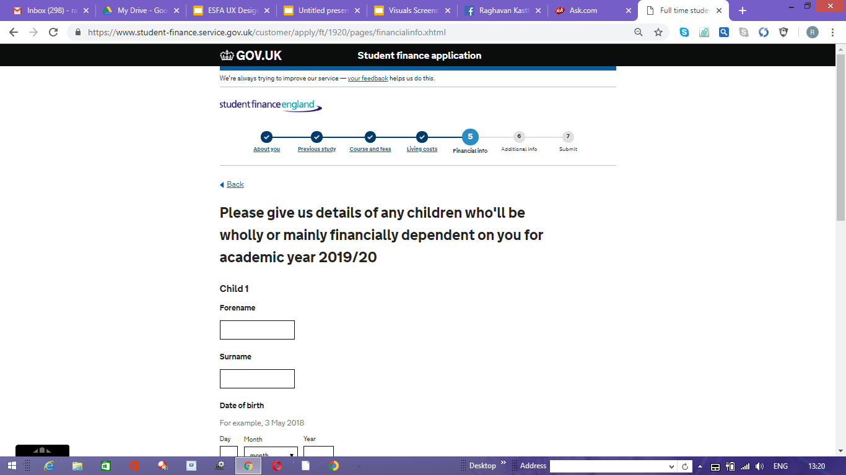

Slide 14
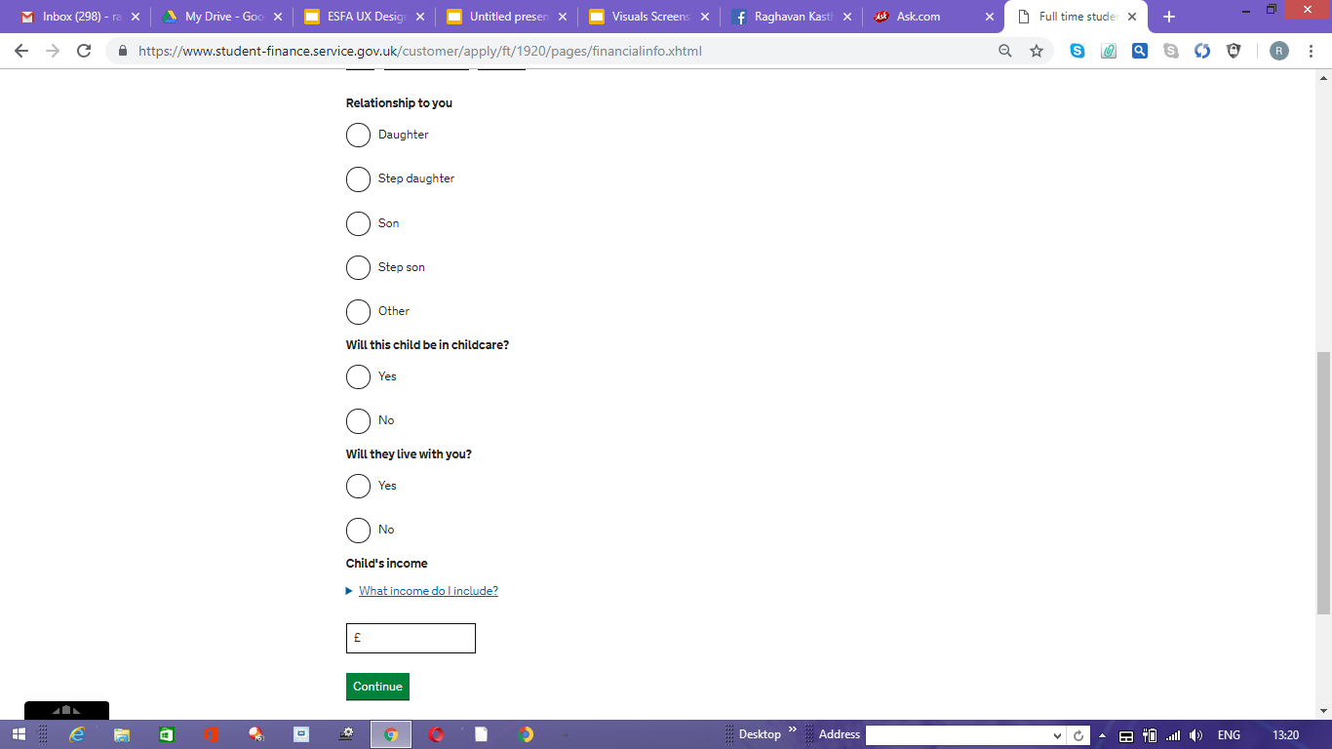

Slide 15
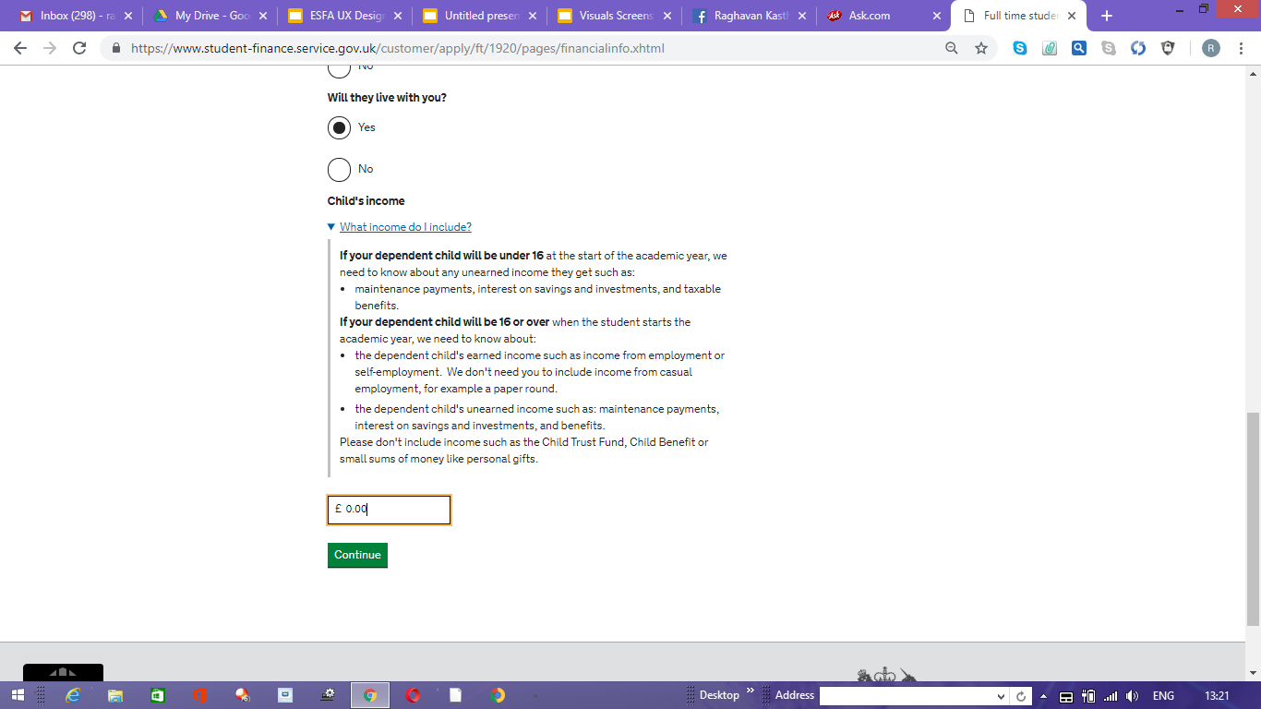

Slide 16
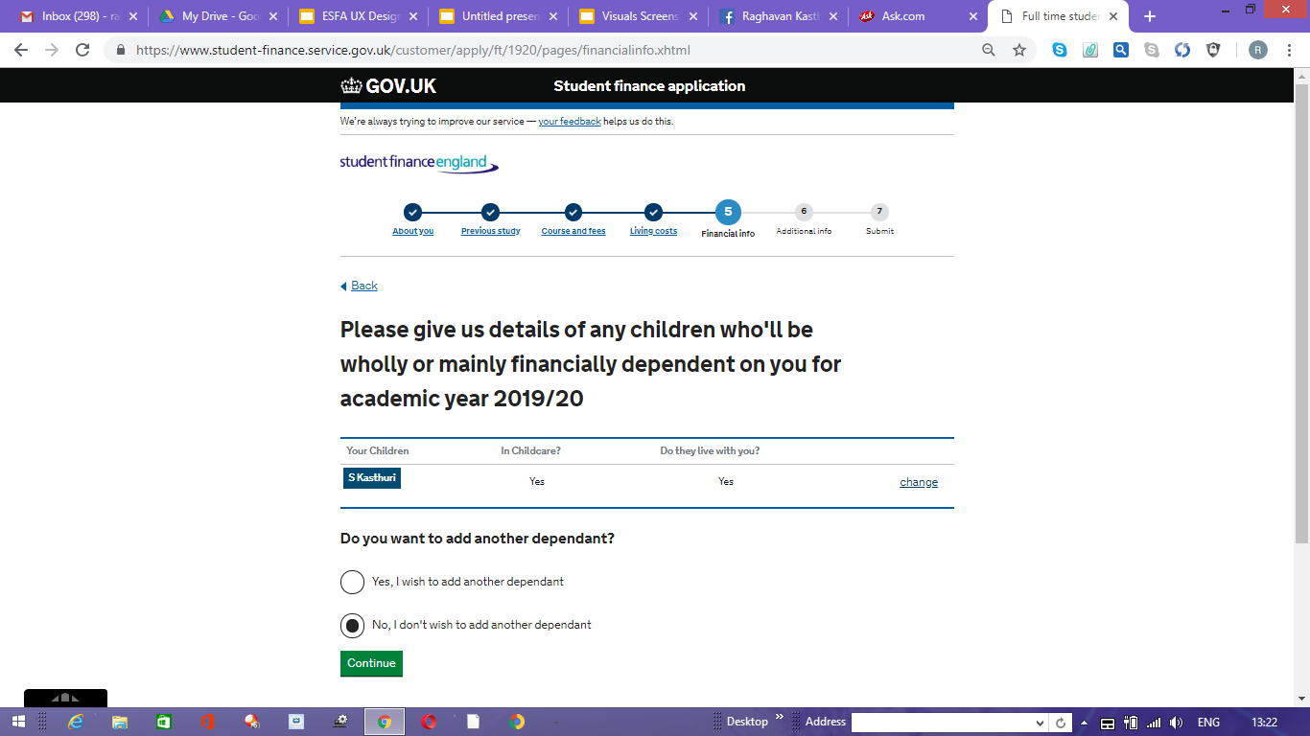

Slide 17
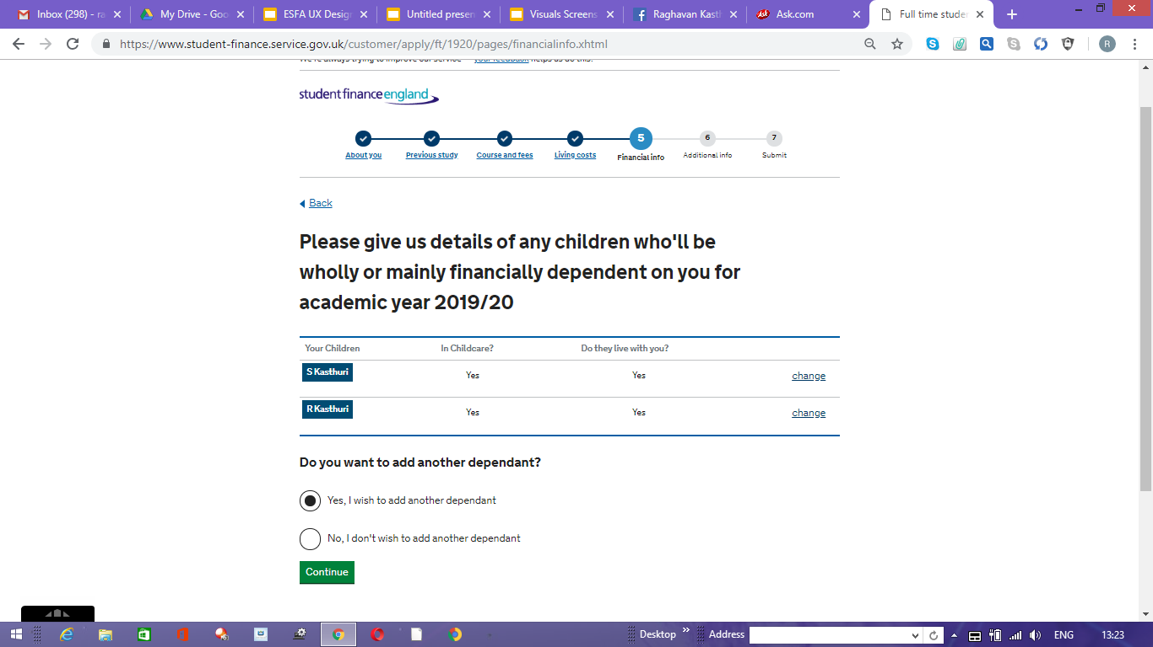

Slide 18
